Slide 1
Efficient Algorithms
Ekkapot Charoenwanit
Software Systems Engineering
TGGS
KMUTNB

Slide 2
Lecture 10: Graph Algorithms (Part II)
Single-Source Shortest Paths

Slide 3
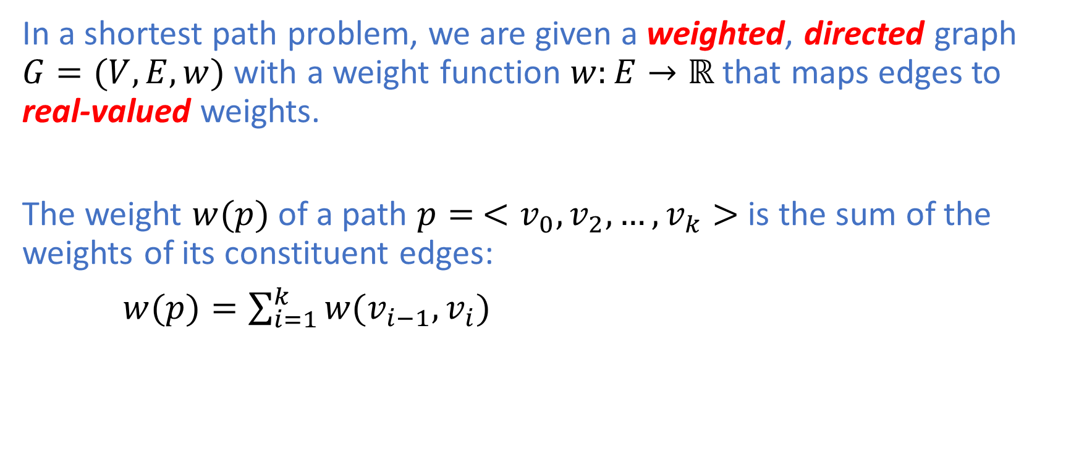
Shortest Path Problem
In a shortest path problem, we are given a weighted, directed graph $G=(V,E,w)$ with a weight function $w:E→ℝ$ that maps edges to real-valued weights.
The weight $w(p)$ of a path $p=$ $<v_{0},v_{2},…,v_{k}>$ is the sum of the weights of its constituent edges:
$w(p)=\sum_{i=1}^{k}{w(v_{i−1},v_{i})}$

Slide 4
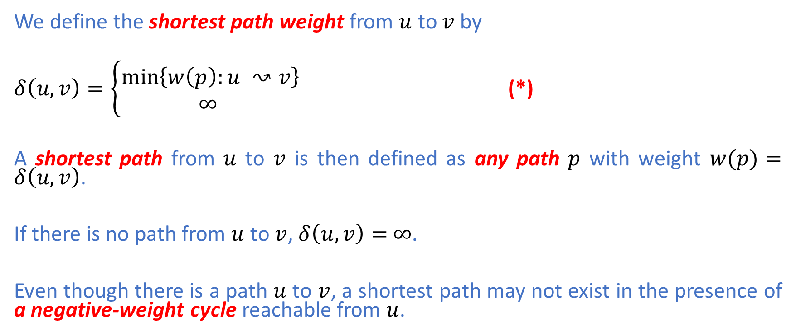
Shortest Path Problem
We define the shortest path weight from $u$ to $v$ by
$δ\left(u,v\right)=\left\{\begin{aligned}\min\left\{w\left(p\right):u ↝v\right\} \\ ∞ \end{aligned}\right.$ (*)
A shortest path from $u$ to $v$ is then defined as any path $p$ with weight $w(p)=δ\left(u,v\right)$.
If there is no path from $u$ to $v$, $δ\left(u,v\right)=$ $∞$.
Even though there is a path $u$ to $v$, a shortest path may not exist in the presence of a negative-weight cycle reachable from $u$.

Slide 5
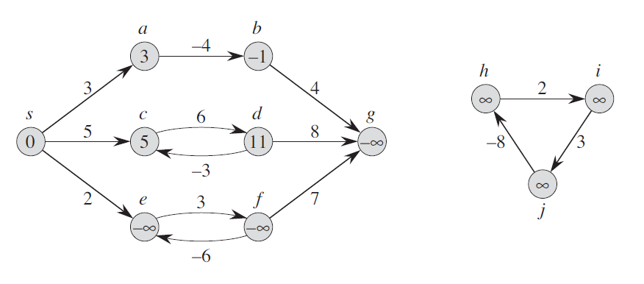
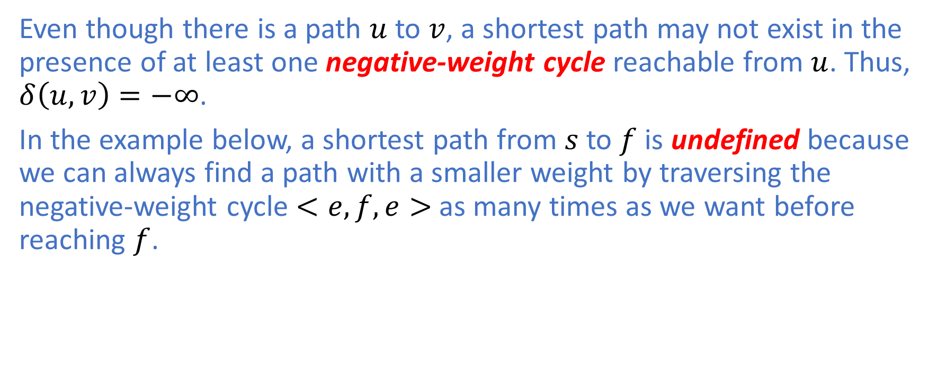
Negative-Weight Cycle
Even though there is a path $u$ to $v$, a shortest path may not exist in the presence of at least one negative-weight cycle reachable from $u$. Thus, $δ\left(u,v\right)=−∞$.
In the example below, a shortest path from $s$ to $f$ is undefined because we can always find a path with a smaller weight by traversing the negative-weight cycle $<e,f,e>$ as many times as we want before reaching $f$.

Slide 6
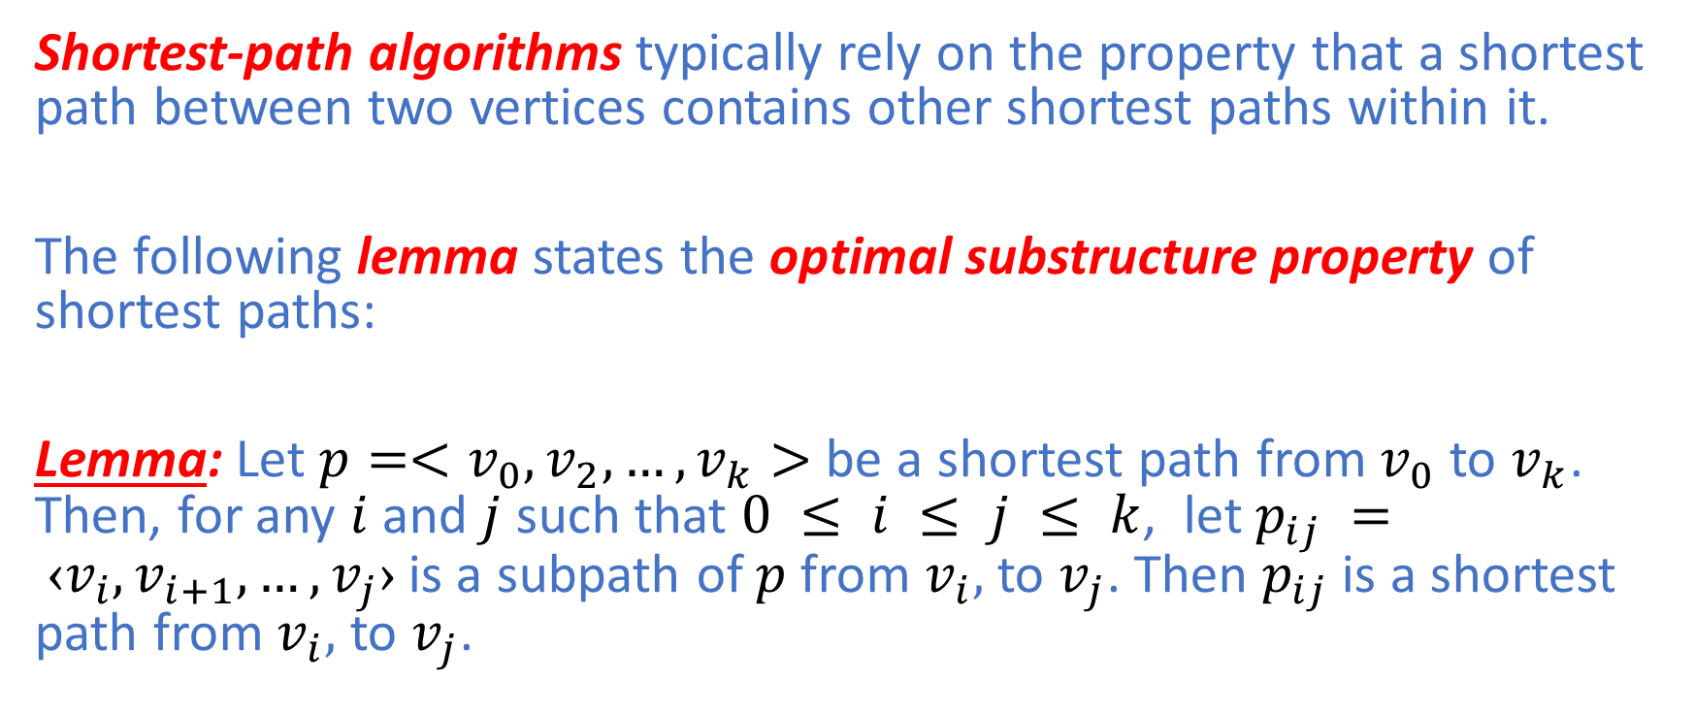
Optimal Substructure
Shortest-path algorithms typically rely on the property that a shortest path between two vertices contains other shortest paths within it.
The following lemma states the optimal substructure property of shortest paths:
Lemma: Let $p=<v_{0},v_{2},…,v_{k}>$ be a shortest path from $v_{0}$ to $v_{k}$. Then, for any $i$ and $j$ such that $0 ≤ i ≤ j ≤ k$, let $p_{ij} = ‹v_{i},v_{i+1}, …,v_{j}›$is a subpath of $p$from $v_{i},$ to $v_{j}$. Then $p_{ij}$is a shortest path from $v_{i},$ to $v_{j}$.

Slide 7
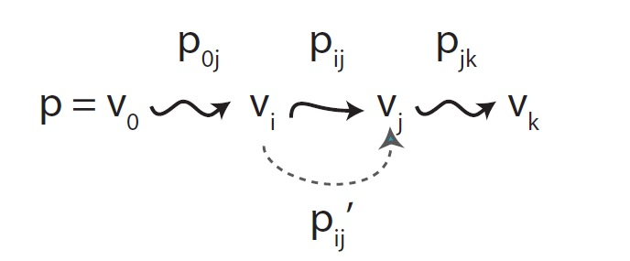

Optimal Substructure
Lemma: Let $p=<v_{0},v_{2},…,v_{k}>$ be a shortest path from $v_{0}$ to $v_{k}$. Then, for any $i$ and $j$ such that $0 ≤ i ≤ j ≤ k$, let $p_{ij} = ‹v_{i},v_{i+1}, …,v_{j}›$is a subpath of $p$from $v_{i},$ to $v_{j}$. Then $p_{ij}$is a shortest path from $v_{i},$ to $v_{j}$.

Slide 8
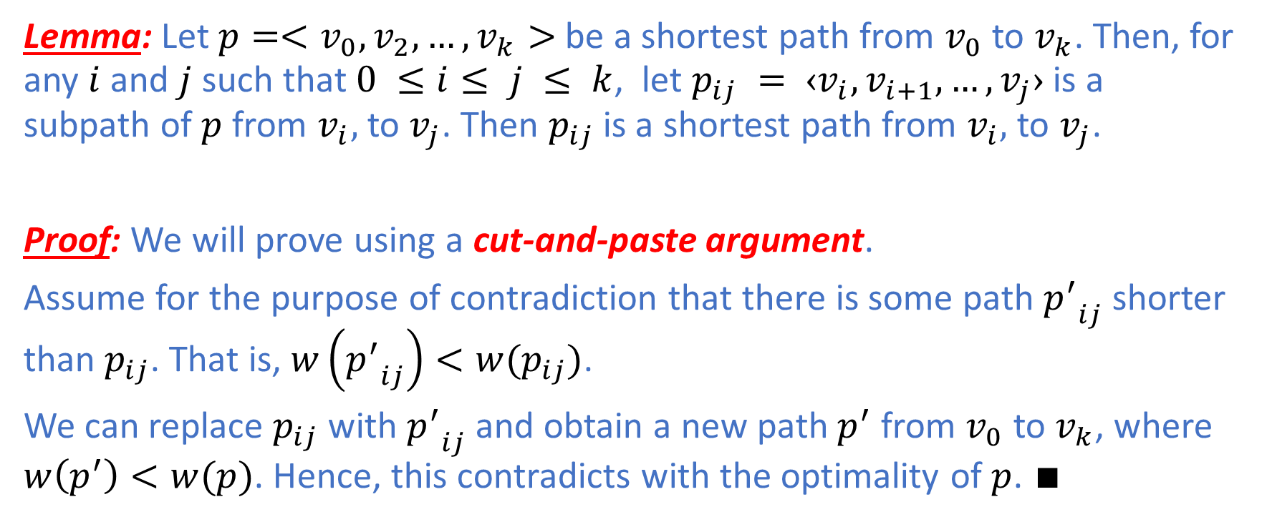
Optimal Substructure
Lemma: Let $p=<v_{0},v_{2},…,v_{k}>$ be a shortest path from $v_{0}$ to $v_{k}$. Then, for any $i$ and $j$ such that $0 ≤i≤ j ≤ k$, let $p_{ij} = ‹v_{i},v_{i+1}, …,v_{j}›$is a subpath of $p$from $v_{i},$ to $v_{j}$. Then $p_{ij}$is a shortest path from $v_{i},$ to $v_{j}$.
Proof: We will prove using a cut-and-paste argument.
Assume for the purpose of contradiction that there is some path ${p^{′}}_{ij}$shorter than $p_{ij}$. That is, $w\left({p^{′}}_{ij}\right)<w(p_{ij})$.
We can replace $p_{ij}$ with ${p^{′}}_{ij}$and obtain a new path $p^{′}$ from $v_{0}$ to $v_{k}$, where $w\left(p^{′}\right)<w(p)$. Hence, this contradicts with the optimality of $p$. $∎$

Slide 9
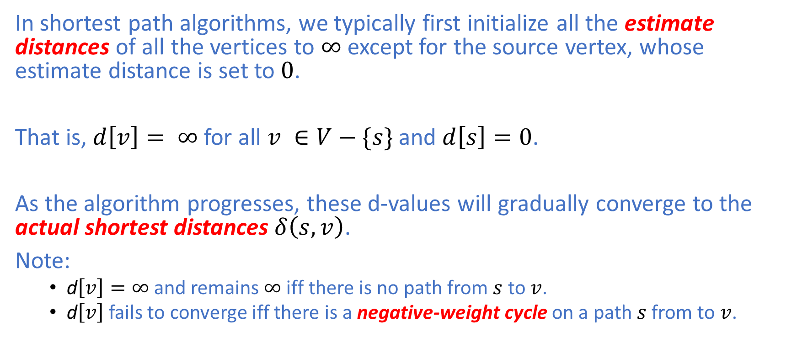
Estimate Distance : The D-Value
In shortest path algorithms, we typically first initialize all the estimate distances of all the vertices to $∞$ except for the source vertex, whose estimate distance is set to $0$.
That is, $d\left[v\right]= ∞$ for all $v ∈V−\{s\}$ and $d\left[s\right]=0$.
As the algorithm progresses, these d-values will gradually converge to the actual shortest distances $δ\left(s,v\right)$.
Note:
d$\left[v\right]=∞$ and remains $∞$ iff there is no path from $s$ to $v$.
d$\left[v\right]$ fails to converge iff there is a negative-weight cycle on a path $s$from to $v$.

Slide 10
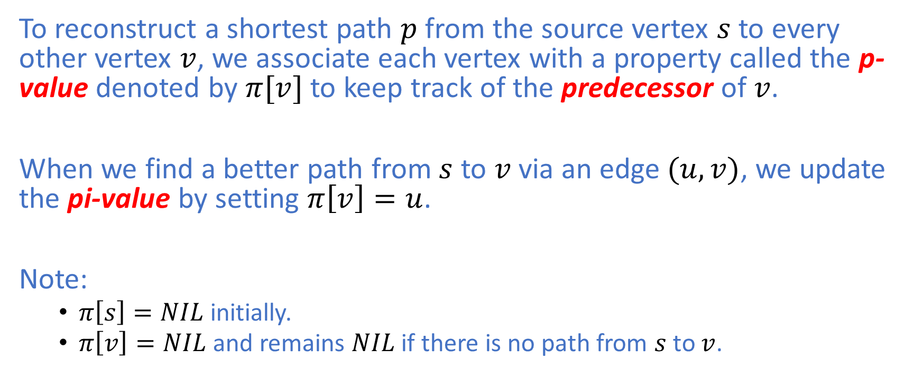
Predecessor: The Pi-Value
To reconstruct a shortest path $p$ from the source vertex $s$ to every other vertex $v$, we associate each vertex with a property called the p-value denoted by $π[v]$ to keep track of the predecessor of $v$.
When we find a better path from $s$ to $v$ via an edge $(u,v)$, we update the pi-value by setting $π\left[v\right]=u$.
Note:
$π\left[s\right]=NIL$ initially.
$π\left[v\right]=NIL$ and remains $NIL$ if there is no path from $s$ to $v$.

Slide 11
General Procedure in SP Problems
Shortest-Path algorithms typically have the following two procedures in common:
The initialization step where all the d-values and pi-values are initialized.
The relaxation step where the d-values and pi-values are updated when a better path for each vertex is found.

Slide 12
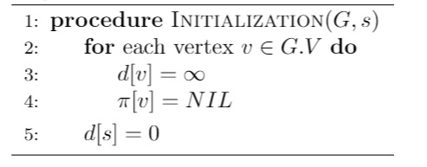

Initialization
The time complexity of $Initialization(G,s)$ is $Θ(V)$.

Slide 13
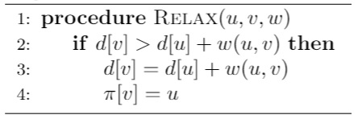

Relaxation
When a better path from $s$ to $v$ via edge $(u,v)$ is found, we update the d-value and the pi-value of $v$ as follows:
We say that the edge $(u,v)$ is relaxed.
The time complexity of $Relax(u,v,w)$ is
$O(\log{V})$ as the assignment in line 3 is, in fact, a $Decrease−Key−Value$ operation if a min-priority queue is used in Djkstra’s algorithm
$Θ(1)$ in Bellman-Ford

Slide 14
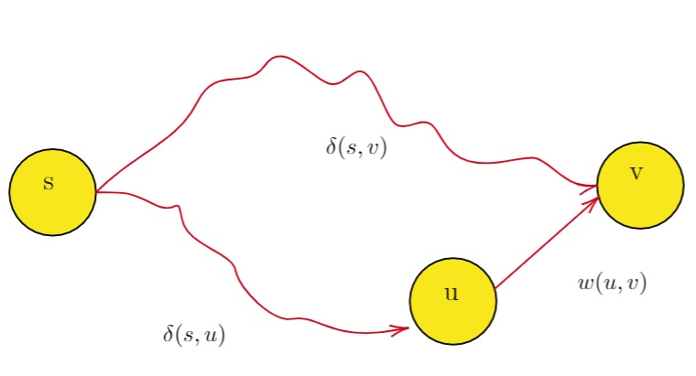
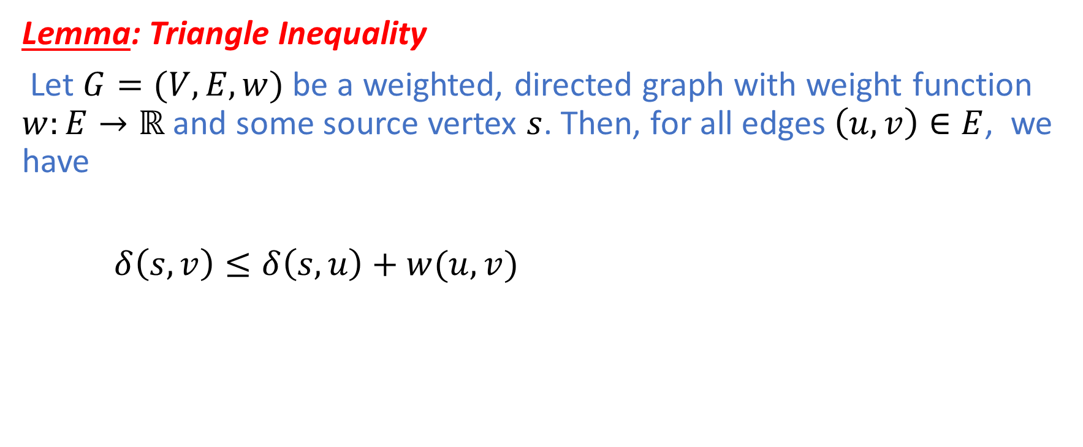
Triangle Inequality
Lemma: Triangle Inequality
Let $G=(V,E,w)$ be a weighted, directed graph with weight function $w:E→ℝ$ and some source vertex $s$. Then, for all edges $\left(u,v\right)∈E$, we have
$δ\left(s,v\right)≤δ\left(s,u\right)+w(u,v)$

Slide 15
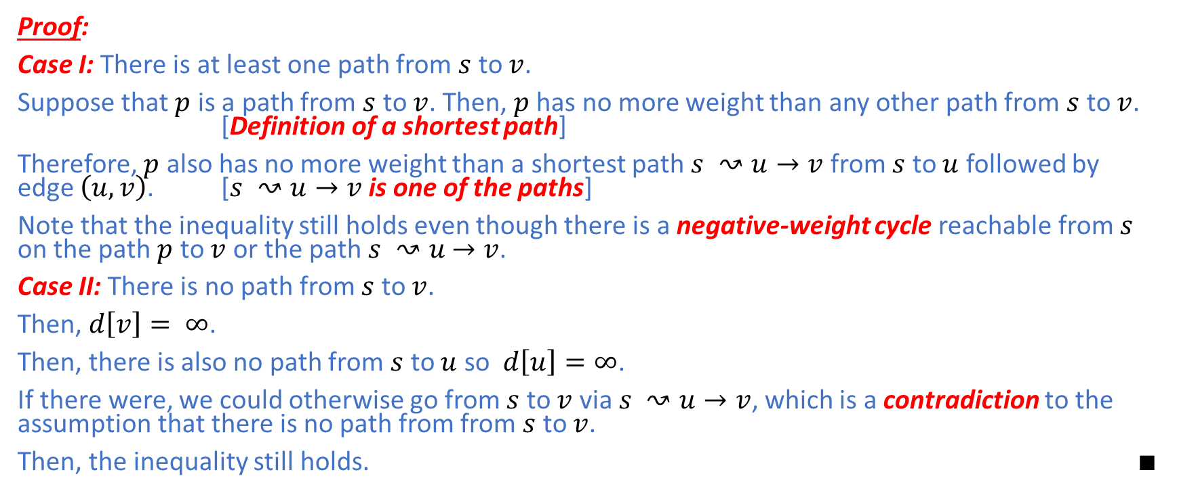
Triangle Inequality
Proof:
Case I: There is at least one path from $s$ to $v$.
Suppose that $p$ is a path from $s$ to $v$. Then, $p$ has no more weight than any other path from $s$ to $v$. [Definition of a shortest path]
Therefore, $p$ also has no more weight than a shortest path $s ↝u→v$ from $s$ to $u$ followed by edge $\left(u,v\right)$. [$s ↝u→v$ is one of the paths]
Note that the inequality still holds even though there is a negative-weight cycle reachable from $s$ on the path $p$ to $v$ or the path $s ↝u$ $→v$.
Case II: There is no path from $s$ to $v$.
Then, $d\left[v\right]= ∞$.
Then, there is also no path from $s$ to $u$ so $d\left[u\right]=∞$.
If there were, we could otherwise go from $s$ to $v$ via $s ↝u→v$, which is a contradiction to the assumption that there is no path from from $s$ to $v$.
Then, the inequality still holds. $∎$

Slide 16
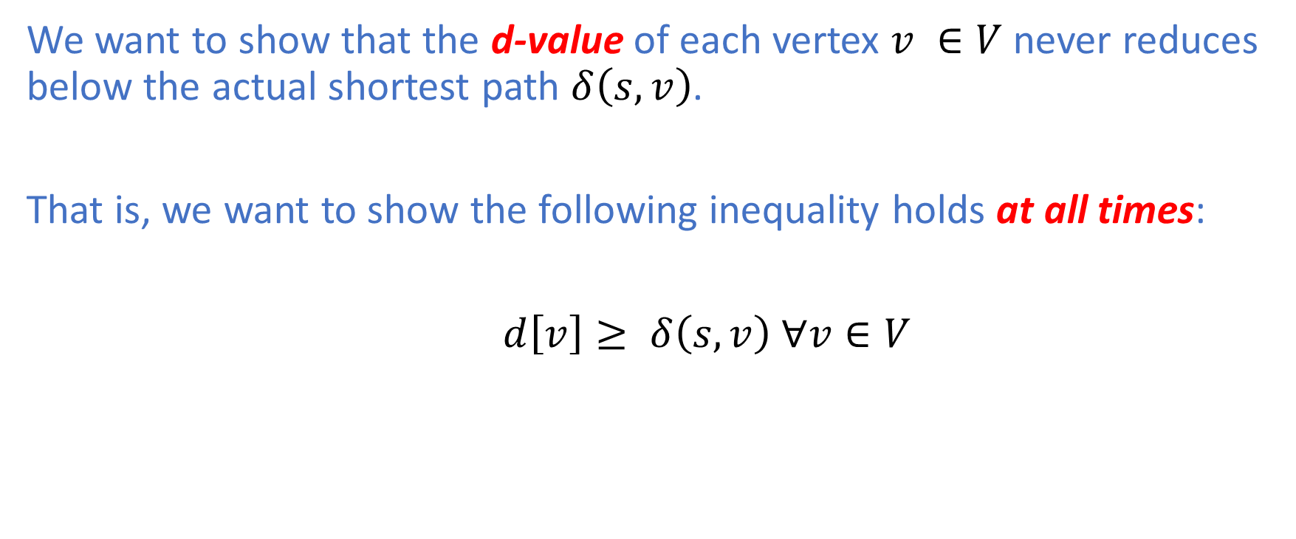
Relaxation is safe
We want to show that the d-value of each vertex $v ∈V$ never reduces below the actual shortest path $δ\left(s,v\right)$.
That is, we want to show the following inequality holds at all times:
$d\left[v\right]≥ δ\left(s,v\right) ∀v∈V$

Slide 17
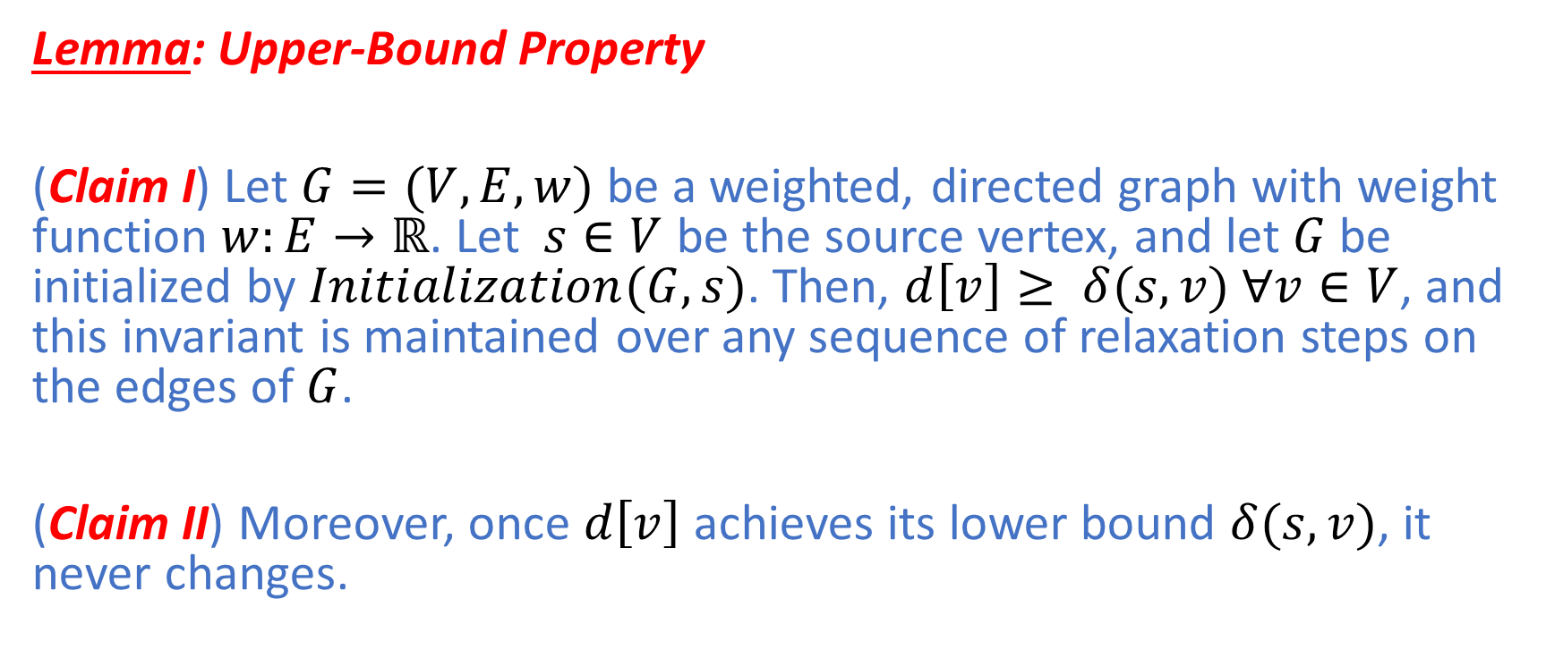
Relaxation is safe
Lemma: Upper-Bound Property
(Claim I) Let $G=(V,E,w)$ be a weighted, directed graph with weight function $w:E→ℝ$. Let $s∈V$ be the source vertex, and let $G$be initialized by $Initialization(G,s)$. Then, $d\left[v\right]≥ δ(s,v)$ $∀v∈V$, and this invariant is maintained over any sequence of relaxation steps on the edges of $G$.
(Claim II) Moreover, once $d\left[v\right]$ achieves its lower bound $δ(s,v)$, it never changes.

Slide 18
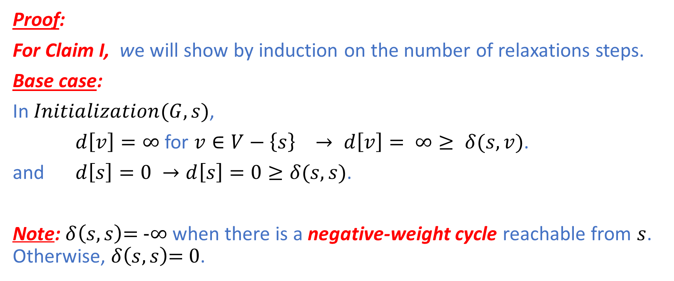
Relaxation is safe
Proof:
For Claim I, we will show by induction on the number of relaxations steps.
Base case:
In $Initialization(G,s)$,
$d\left[v\right]=∞$ for $v∈V−\left\{s\right\} → d\left[v\right]= ∞≥ δ(s,v)$.
and $d\left[s\right]=0 →d\left[s\right]=0≥δ(s,s)\text{.}$
Note: $δ\left(s,s\right)\text{= −}∞$ when there is a negative-weight cycle reachable from $s$. Otherwise, $δ\left(s,s\right)\text{= }\text{0}$.

Slide 19
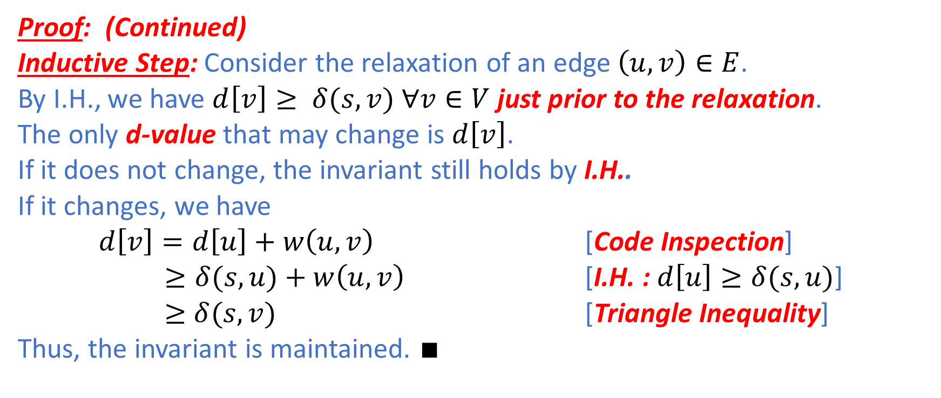
Relaxation is safe
Proof: (Continued)
Inductive Step: Consider the relaxation of an edge $\left(u,v\right)∈E$.
By I.H., we have $d\left[v\right]≥ δ(s,v)$ $∀v∈V$ just prior to the relaxation.
The only d-value that may change is $d\left[v\right]$.
If it does not change, the invariant still holds by I.H..
If it changes, we have
$d\left[v\right]=d\left[u\right]+w\left(u,v\right)$ [Code Inspection]
$≥δ(s,u)+w\left(u,v\right)$ [I.H. : $d\left[u\right]≥δ(s,u)$]
$≥$ $δ(s,v)$ [Triangle Inequality]
Thus, the invariant is maintained. $∎$

Slide 20
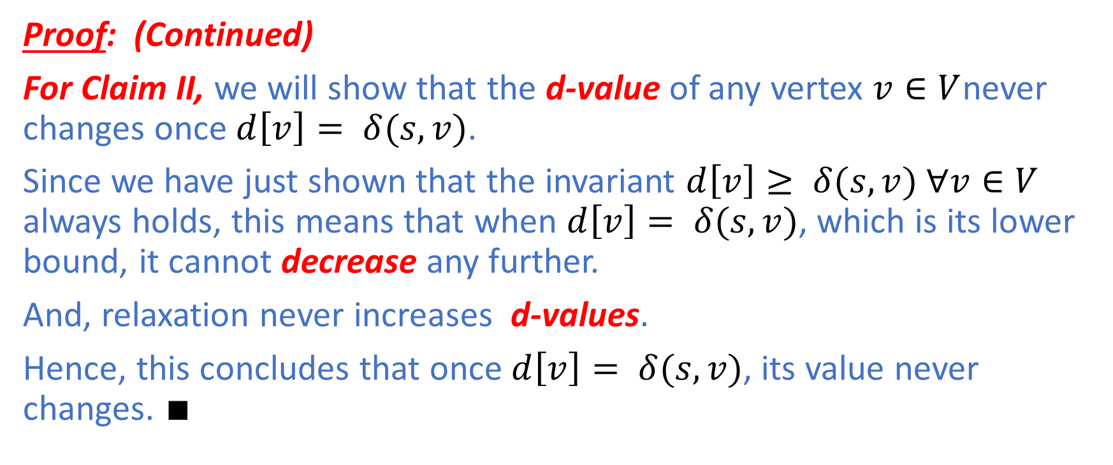
Relaxation is safe
Proof: (Continued)
For Claim II, we will show that the d-value of any vertex $v∈V$never changes once $d\left[v\right]= δ(s,v)$.
Since we have just shown that the invariant $d\left[v\right]≥ δ(s,v)$ $∀v∈V$ always holds, this means that when $d\left[v\right]= δ(s,v)$, which is its lower bound, it cannot decrease any further.
And, relaxation never increases d-values.
Hence, this concludes that once $d\left[v\right]= δ(s,v)$, its value never changes. $∎$

Slide 21
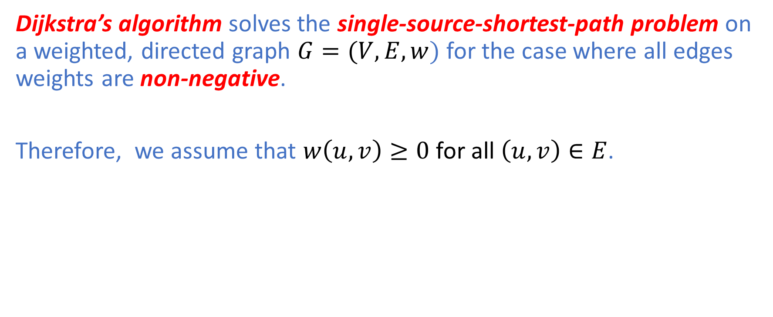
Dijkstra’s Algorithm
Dijkstra’s algorithm solves the single-source-shortest-path problem on a weighted, directed graph $G=(V,E,w)$ for the case where all edges weights are non-negative.
Therefore, we assume that $w\left(u,v\right)≥0$ for all $\left(u,v\right)∈E$.

Slide 22
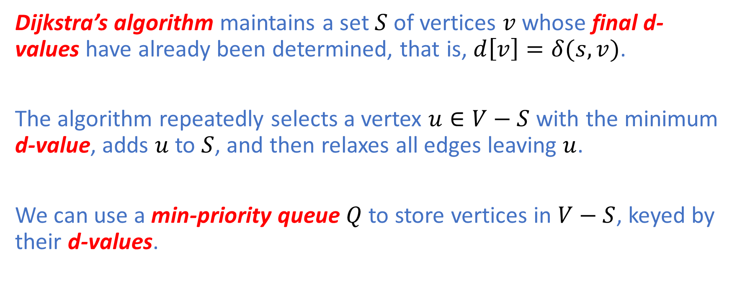
Dijkstra’s Algorithm
Dijkstra’s algorithm maintains a set $S$ of vertices $v$ whose final d-values have already been determined, that is, $d\left[v\right]=δ(s,v)$.
The algorithm repeatedly selects a vertex $u∈V−S$ with the minimum d-value, adds $u$ to $S$, and then relaxes all edges leaving $u$.
We can use a min-priority queue $Q$ to store vertices in $V−S$, keyed by their d-values.

Slide 23
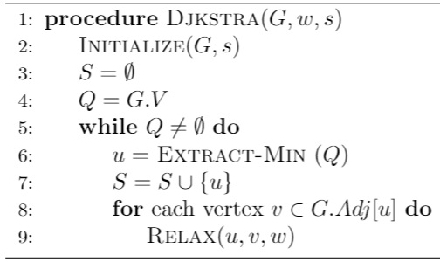

Dijkstra’s Algorithm
The algorithm maintains the invariant that $Q=V−S$ at the start of each iteration of the while loop of lines 5-9.

Slide 24
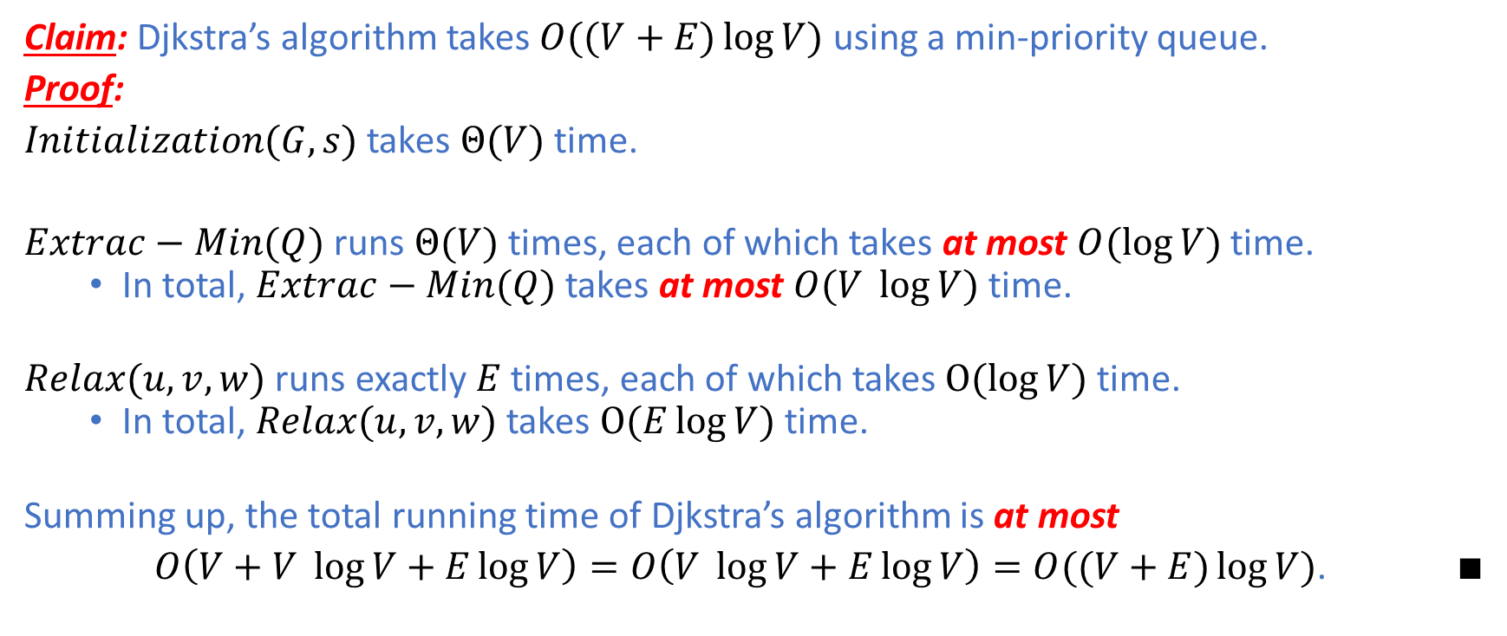
Djkstra’s Algorithm : Analysis
Claim: Djkstra’s algorithm takes $O((V+E)\log{V})$ using a min-priority queue.
Proof:
$Initialization(G,s)$ takes $Θ(V)$ time.
$Extrac−Min(Q)$ runs $Θ(V)$ times, each of which takes at most $O(\log{V})$ time.
In total, $Extrac−Min(Q)$ takes at most $O(V \log{V})$ time.
$Relax(u,v,w)$ runs exactly $E$ times, each of which takes $O(\log{V})$ time.
In total, $Relax(u,v,w)$ takes $O(E\log{V})$ time.
Summing up, the total running time of Djkstra’s algorithm is at most
$O\left(V+V \log{V}+E\log{V}\right)=O\left(V \log{V}+E\log{V}\right)=O((V+E)\log{V})$. $∎$

Slide 25
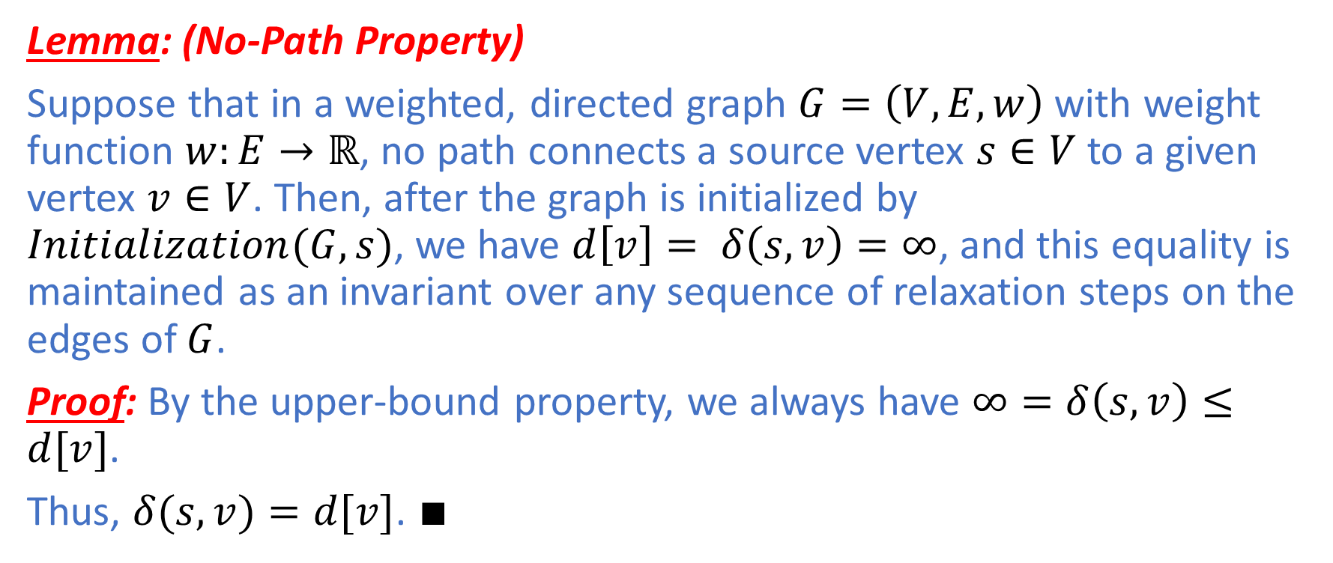
No-Path Property
Lemma: (No-Path Property)
Suppose that in a weighted, directed graph $G=\left(V,E,w\right)$ with weight function $w:E→ℝ$, no path connects a source vertex $s∈V$ to a given vertex $v∈V$. Then, after the graph is initialized by $Initialization(G,s)$, we have $d\left[v\right]= δ\left(s,v\right)=∞$, and this equality is maintained as an invariant over any sequence of relaxation steps on the edges of $G$.
Proof: By the upper-bound property, we always have $∞=δ\left(s,v\right)≤d[v]$.
Thus, $δ(s,v)=d[v]$. $∎$

Slide 26
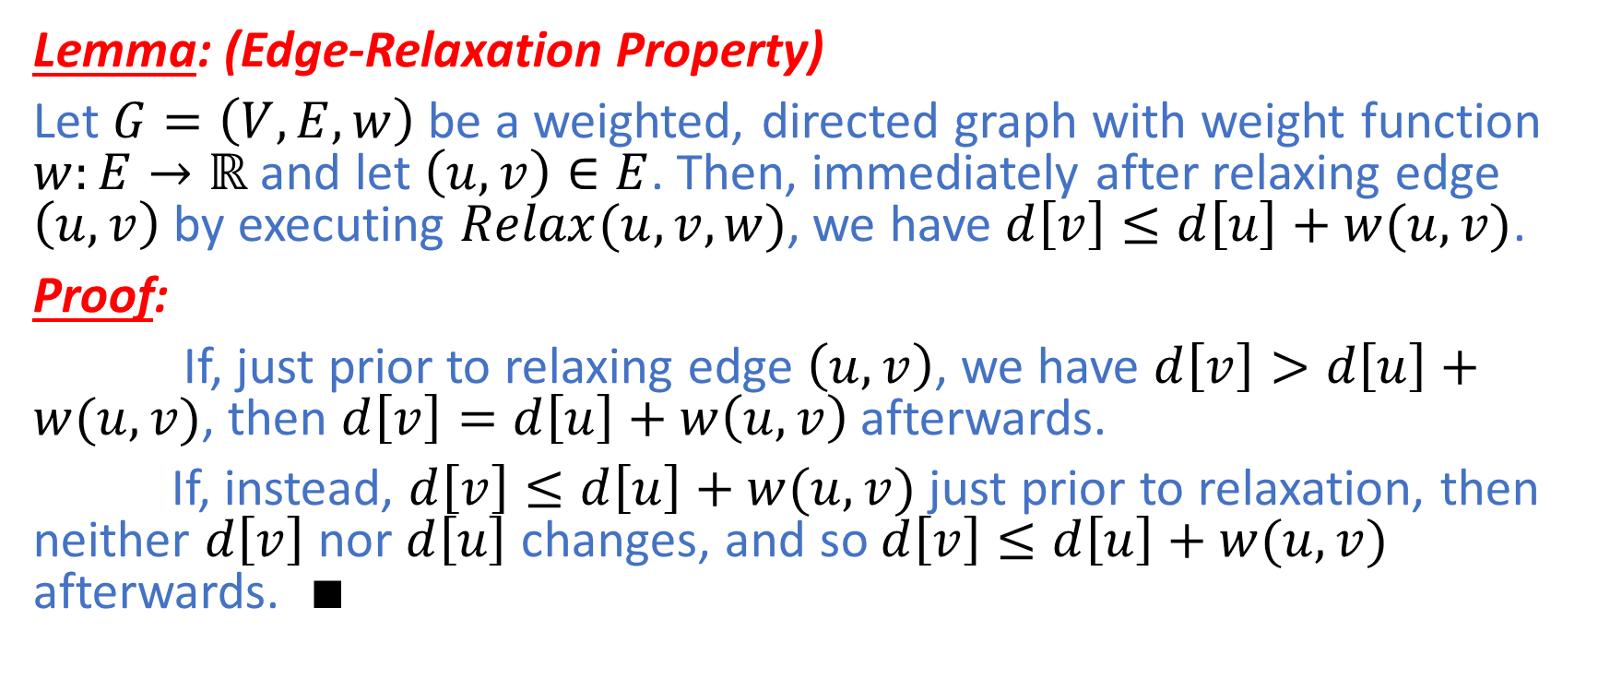
Edge-Relaxation Property
Lemma: (Edge-Relaxation Property)
Let $G=\left(V,E,w\right)$ be a weighted, directed graph with weight function $w:E→ℝ$ and let $\left(u,v\right)∈E$. Then, immediately after relaxing edge $\left(u,v\right)$ by executing $Relax(u,v,w)$, we have $d\left[v\right]≤d\left[u\right]+w(u,v)$.
Proof:
If, just prior to relaxing edge $\left(u,v\right)$, we have $d\left[v\right]>d\left[u\right]+w(u,v)$, then $d\left[v\right]=d\left[u\right]+w\left(u,v\right)$ afterwards.
If, instead, $d\left[v\right]≤d\left[u\right]+w(u,v)$ just prior to relaxation, then neither $d\left[v\right]$ nor $d\left[u\right]$ changes, and so $d\left[v\right]≤d\left[u\right]+w(u,v)$ afterwards. $∎$

Slide 27
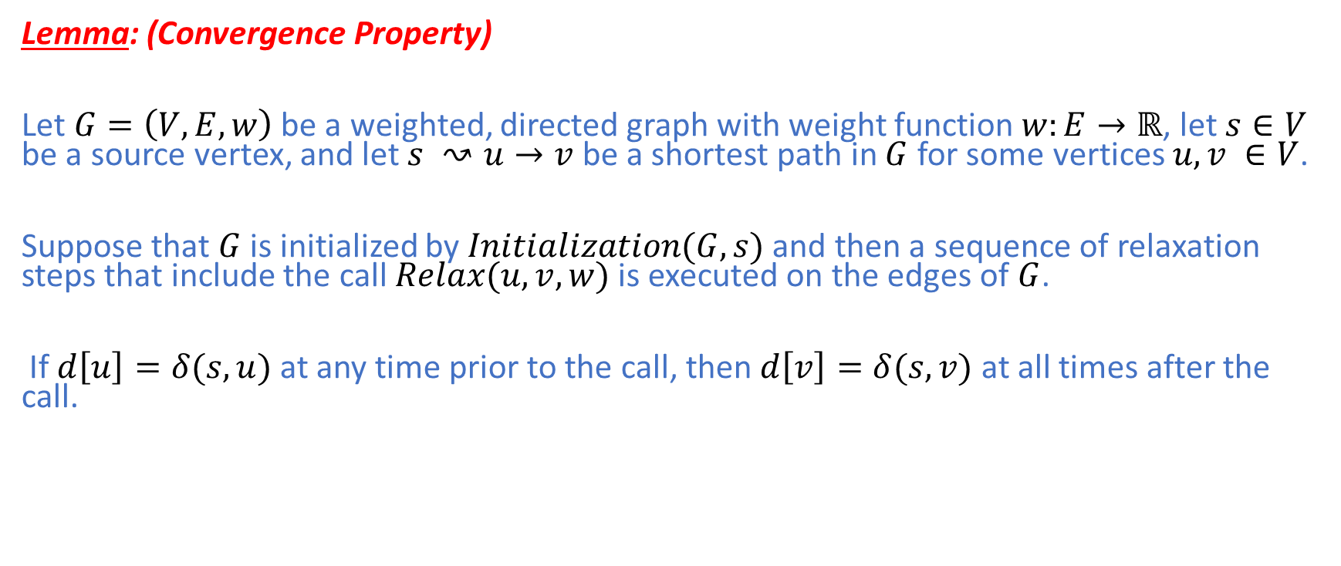
Convergence Property
Lemma: (Convergence Property)
Let $G=\left(V,E,w\right)$ be a weighted, directed graph with weight function $w:E→ℝ$, let $s∈V$ be a source vertex, and let $s ↝u→v$ be a shortest path in $G$ for some vertices $u,v ∈V$.
Suppose that $G$ is initialized by $Initialization(G,s)$ and then a sequence of relaxation steps that include the call $Relax(u,v,w)$ is executed on the edges of $G$.
If $d\left[u\right]=δ(s,u)$ at any time prior to the call, then $d\left[v\right]=δ(s,v)$ at all times after the call.

Slide 28
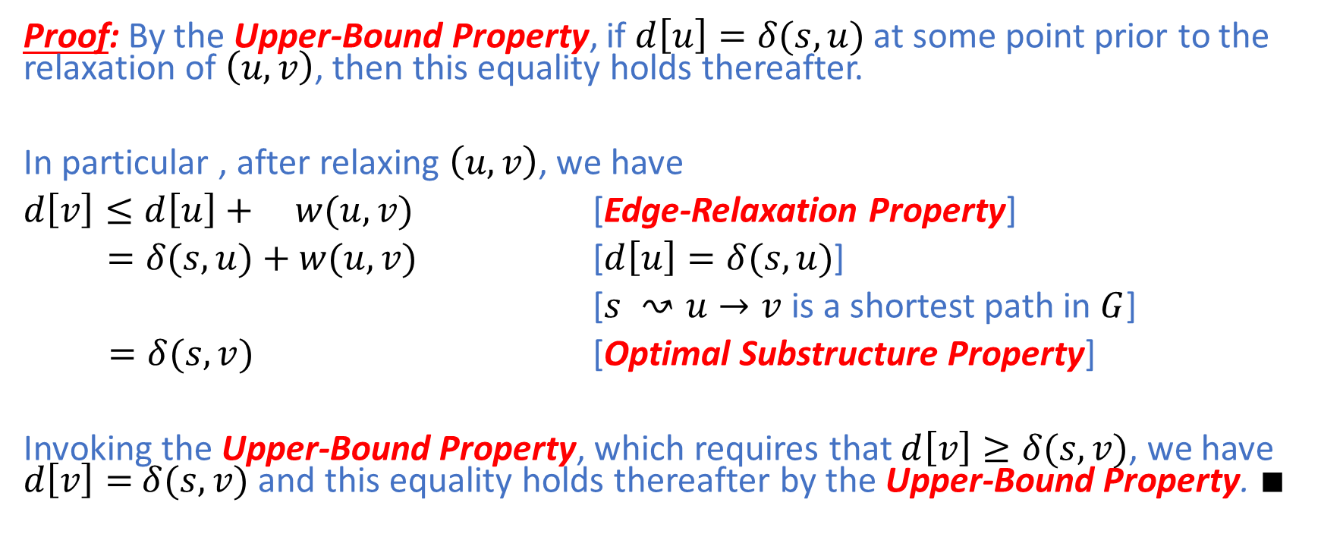
Convergence Property
Proof: By the Upper-Bound Property, if $d\left[u\right]=δ(s,u)$ at some point prior to the relaxation of $\left(u,v\right)$, then this equality holds thereafter.
In particular , after relaxing $\left(u,v\right)$, we have
$d\left[v\right]≤d\left[u\right]+ w(u,v)$ [Edge-Relaxation Property]
$=δ(s,u)+w(u,v)$ [$d\left[u\right]=δ(s,u)$]
[$s ↝u→v$ is a shortest path in $G$]
$=δ(s,v)$ [Optimal Substructure Property]
Invoking the Upper-Bound Property, which requires that $d\left[v\right]≥δ(s,v)$, we have $d\left[v\right]=$ $δ(s,v)$ and this equality holds thereafter by the Upper-Bound Property. $∎$

Slide 29
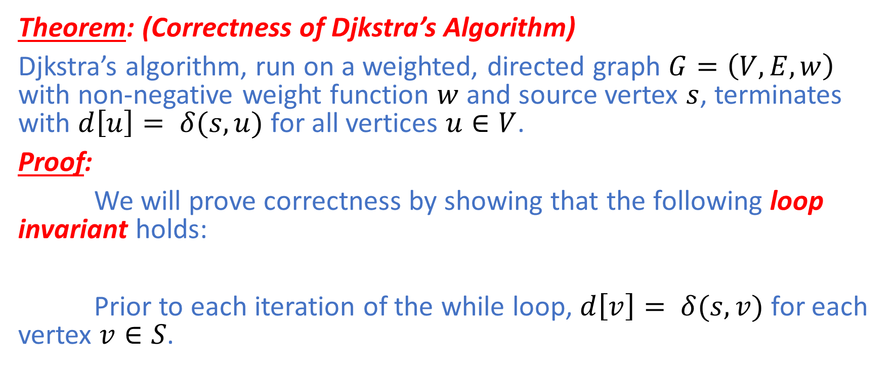
Djkstra’s Algorithm : Correctness
Theorem: (Correctness of Djkstra’s Algorithm)
Djkstra’s algorithm, run on a weighted, directed graph $G=\left(V,E,w\right)$ with non-negative weight function $w$ and source vertex $s$, terminates with $d\left[u\right]= δ(s,u)$ for all vertices $u∈V$.
Proof:
We will prove correctness by showing that the following loop invariant holds:
Prior to each iteration of the while loop, $d\left[v\right]= δ(s,v)$ for each vertex $v∈S$.

Slide 30
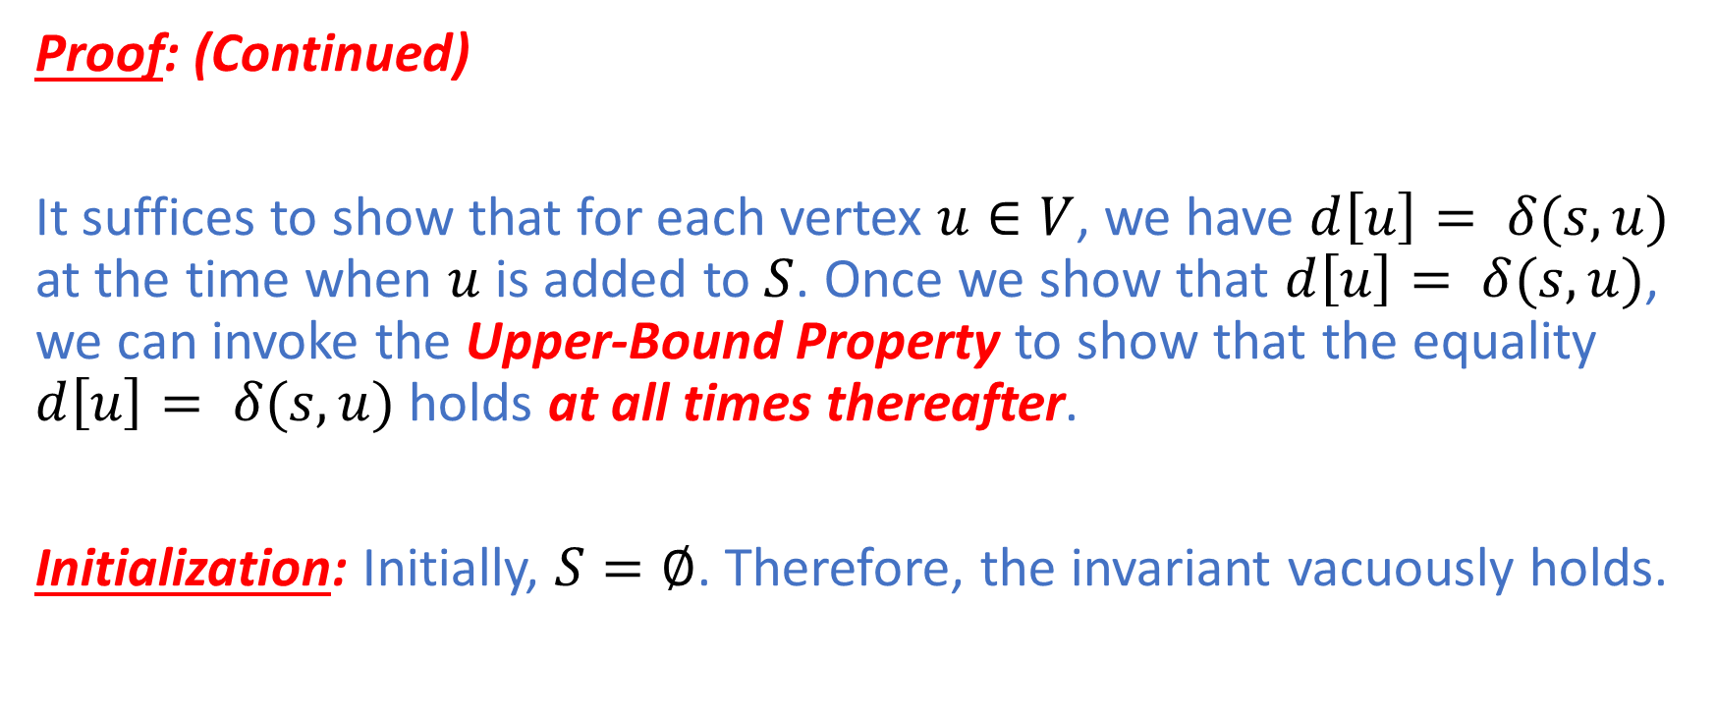
Djkstra’s Algorithm : Correctness
Proof: (Continued)
It suffices to show that for each vertex $u∈V$, we have $d\left[u\right]= δ(s,u)$ at the time when $u$ is added to $S$. Once we show that $d\left[u\right]= δ(s,u)$, we can invoke the Upper-Bound Property to show that the equality $d\left[u\right]= δ(s,u)$ holds at all times thereafter.
Initialization: Initially, $S=∅$. Therefore, the invariant vacuously holds.

Slide 31
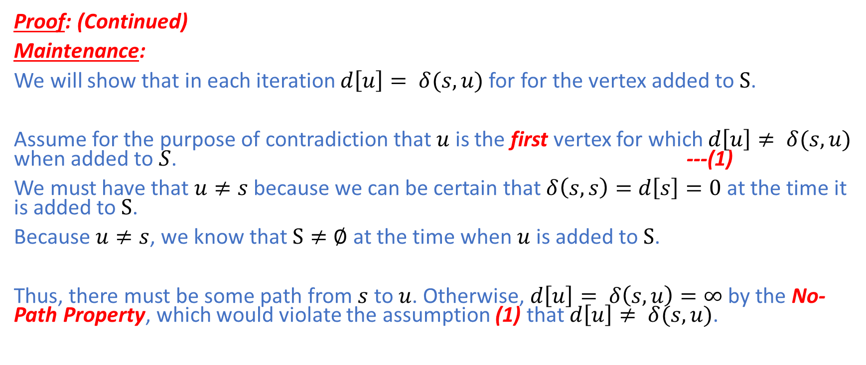
Djkstra’s Algorithm : Correctness
Proof: (Continued)
Maintenance:
We will show that in each iteration $d\left[u\right]= δ(s,u)$ for for the vertex added to $S$.
Assume for the purpose of contradiction that $u$ is the first vertex for which $d\left[u\right]≠ δ(s,u)$ when added to $S$. ---(1)
We must have that $u≠s$ because we can be certain that $δ\left(s,s\right)=d\left[s\right]=0$ at the time it is added to $S$.
Because $u≠s$, we know that $S≠∅$ at the time when $u$ is added to $S$.
Thus, there must be some path from $s$ to $u$. Otherwise, $d\left[u\right]= δ\left(s,u\right)=∞$ by the No-Path Property, which would violate the assumption (1) that $d\left[u\right]≠ δ(s,u)$.

Slide 32
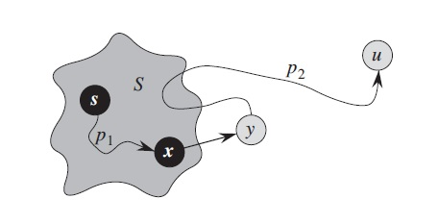
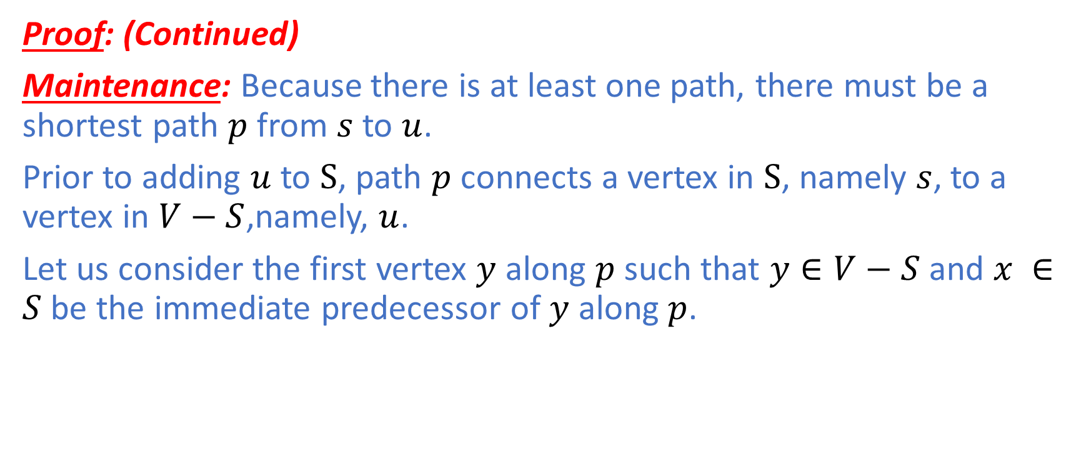
Djkstra’s Algorithm : Correctness
Proof: (Continued)
Maintenance: Because there is at least one path, there must be a shortest path $p$ from $s$ to $u$.
Prior to adding $u$ to $S$, path $p$ connects a vertex in $S$, namely $s$, to a vertex in $V−S$,namely, $u$.
Let us consider the first vertex $y$ along $p$ such that $y∈V−S$ and $x ∈S$ be the immediate predecessor of $y$ along $p$.

Slide 33
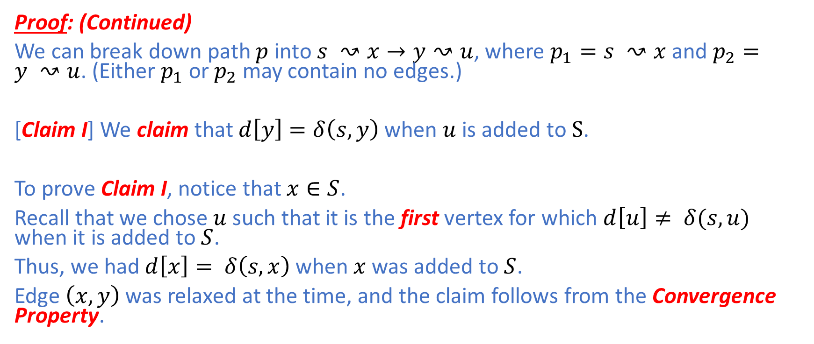
Djkstra’s Algorithm : Correctness
Proof: (Continued)
We can break down path $p$ into $s ↝x→y↝u$, where $p_{1}=s ↝x$ and $p_{2}=y ↝u$. (Either $p_{1}$ or $p_{2}$ may contain no edges.)
[Claim I] We claim that $d\left[y\right]=δ\left(s,y\right)$ when $u$ is added to $S$.
To prove Claim I, notice that $x∈S$.
Recall that we chose $u$ such that it is the first vertex for which $d\left[u\right]≠ δ(s,u)$ when it is added to $S$.
Thus, we had$d\left[x\right]= δ\left(s,x\right)$ when $x$ was added to $S$.
Edge $\left(x,y\right)$ was relaxed at the time, and the claim follows from the Convergence Property.

Slide 34
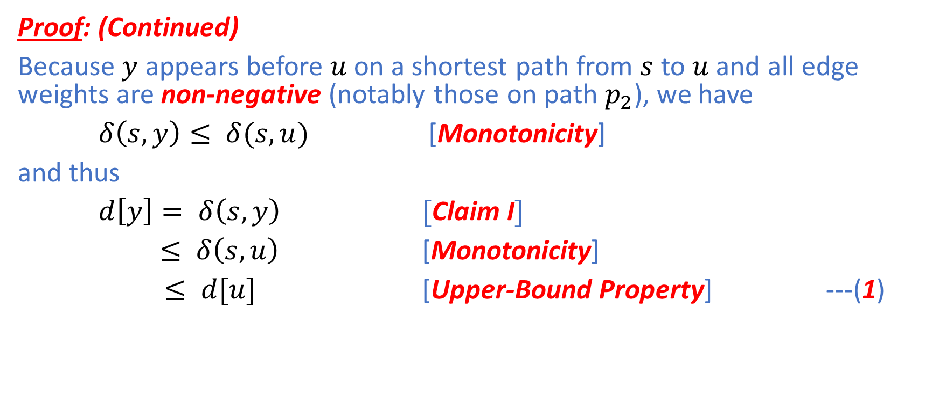
Djkstra’s Algorithm : Correctness
Proof: (Continued)
Because $y$ appears before $u$ on a shortest path from $s$ to $u$ and all edge weights are non-negative (notably those on path $p_{2}$), we have
$δ\left(s,y\right)≤ δ(s,u)$ [Monotonicity]
and thus
$d\left[y\right]= δ\left(s,y\right)$ [Claim I]
$≤ δ\left(s,u\right)$ [Monotonicity]
$≤ d[u]$ [Upper-Bound Property] ---(1)

Slide 35
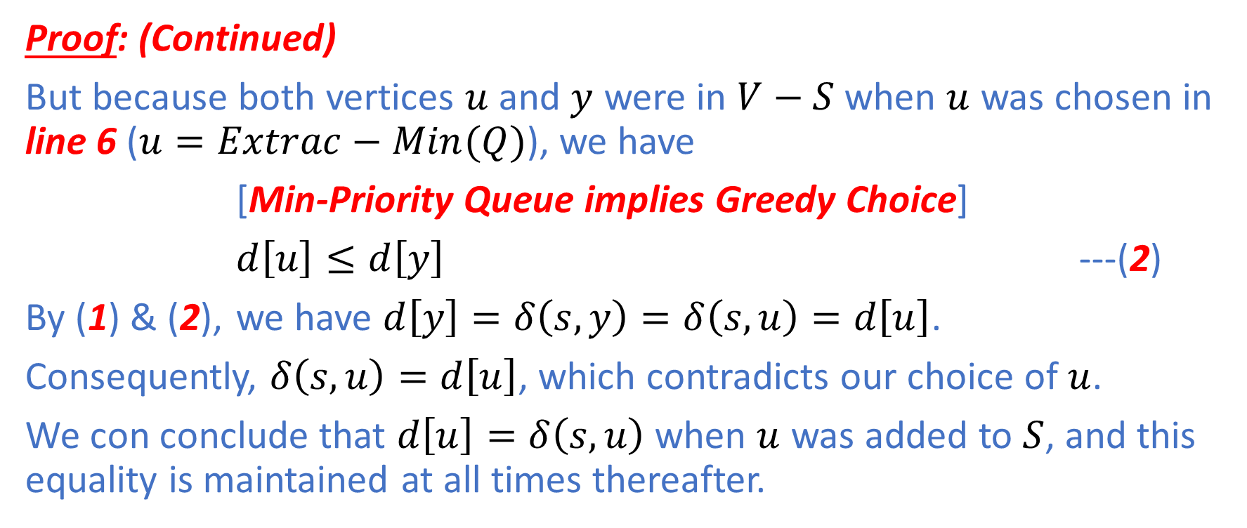
Djkstra’s Algorithm : Correctness
Proof: (Continued)
But because both vertices $u$ and $y$ were in $V−S$ when $u$ was chosen in line 6 ($u=Extrac−Min(Q)$), we have
[Min-Priority Queue implies Greedy Choice]
$d\left[u\right]≤d\left[y\right]$ ---(2)
By (1) & (2), we have $d\left[y\right]=δ\left(s,y\right)=δ\left(s,u\right)=d\left[u\right]$.
Consequently, $δ\left(s,u\right)=d\left[u\right]$, which contradicts our choice of$u$.
We con conclude that $d\left[u\right]=δ\left(s,u\right)$ when $u$ was added to $S$, and this equality is maintained at all times thereafter.

Slide 36
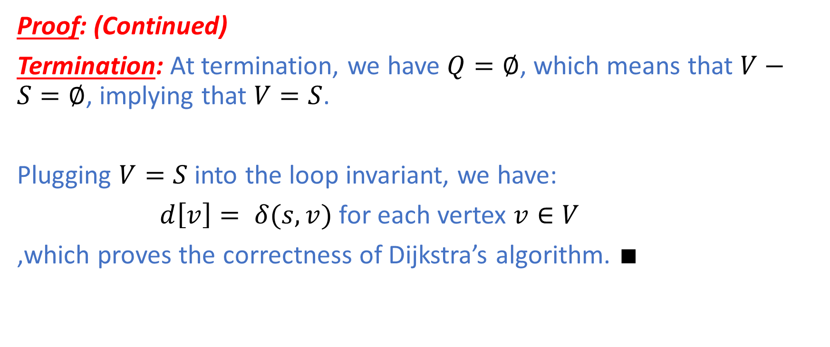
Djkstra’s Algorithm : Correctness
Proof: (Continued)
Termination: At termination, we have $Q=∅$, which means that $V−S=∅$, implying that $V=S$.
Plugging $V=S$ into the loop invariant, we have:
$d\left[v\right]= δ(s,v)$ for each vertex $v∈V$
,which proves the correctness of Dijkstra’s algorithm. $∎$

Slide 37
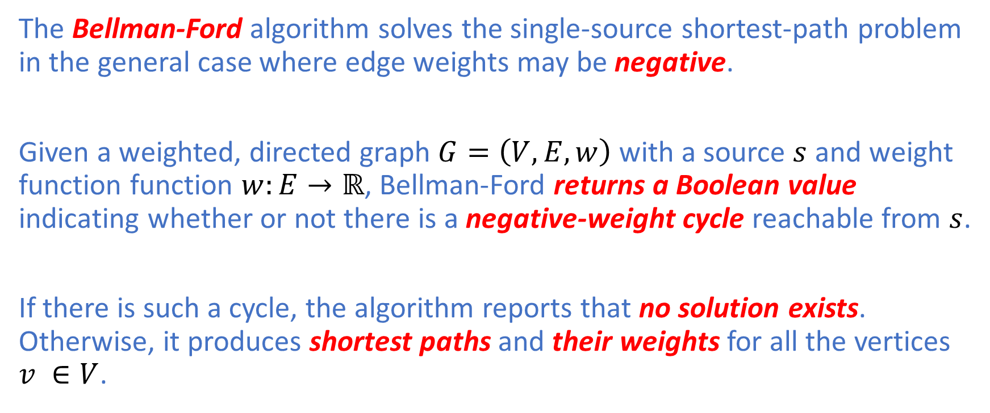
Bellman-Ford
The Bellman-Ford algorithm solves the single-source shortest-path problem in the general case where edge weights may be negative.
Given a weighted, directed graph $G=\left(V,E,w\right)$ with a source $s$ and weight function function $w:E→ℝ$, Bellman-Ford returns a Boolean value indicating whether or not there is a negative-weight cycle reachable from $s$.
If there is such a cycle, the algorithm reports that no solution exists. Otherwise, it produces shortest paths and their weights for all the vertices $v ∈V$.

Slide 38
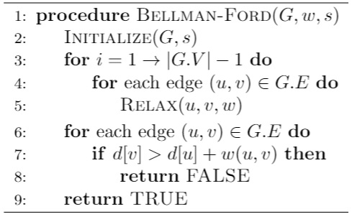

Bellman-Ford
The algorithm proceeds by relaxing edges, hence progressively decreasing the d-value of each vertex $v ∈V$ until it achieves the actual shortest-path values $δ(s,v)$.

Slide 39
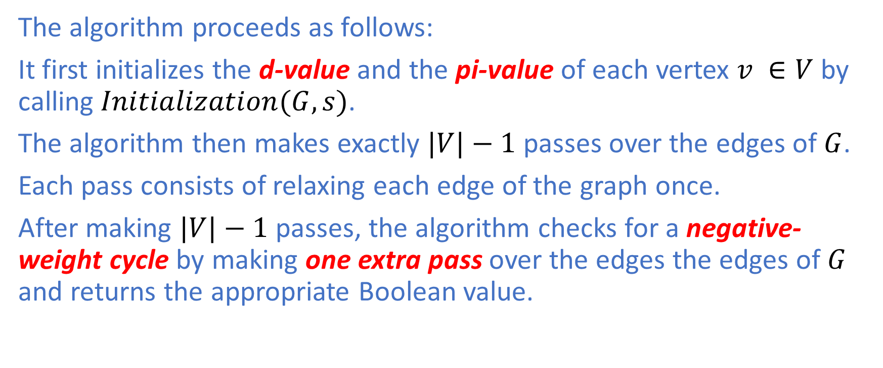
Bellman-Ford
The algorithm proceeds as follows:
It first initializes the d-value and the pi-value of each vertex $v ∈V$ by calling $Initialization(G,s)$.
The algorithm then makes exactly $|V|−1$ passes over the edges of $G$.
Each pass consists of relaxing each edge of the graph once.
After making $|V|−1$ passes, the algorithm checks for a negative-weight cycle by making one extra pass over the edges the edges of $G$ and returns the appropriate Boolean value.

Slide 40
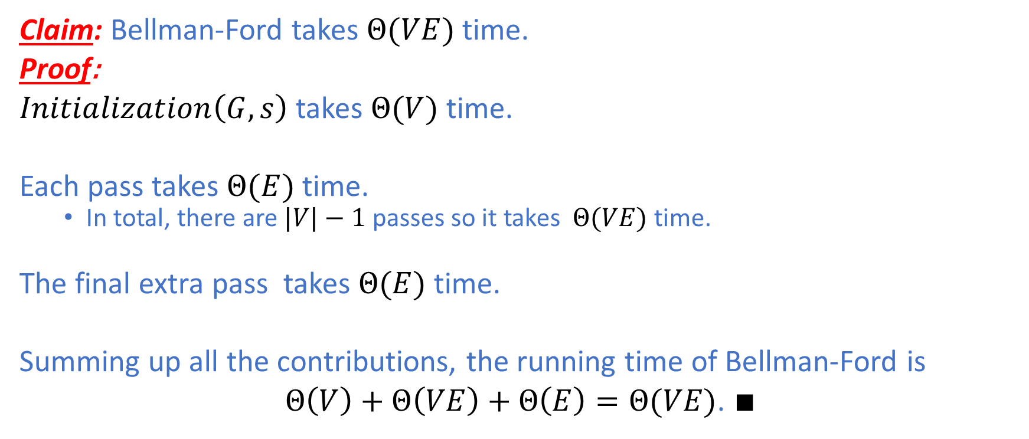
Bellman-Ford: Analysis
Claim: Bellman-Ford takes $Θ(VE)$ time.
Proof:
$Initialization\left(G,s\right)$ takes $Θ(V)$ time.
Each pass takes $Θ(E)$ time.
In total, there are $|V|−1$ passes so it takes $Θ(VE)$ time.
The final extra pass takes $Θ(E)$ time.
Summing up all the contributions, the running time of Bellman-Ford is
$Θ\left(V\right)+Θ\left(VE\right)+Θ\left(E\right)=Θ(VE)$. $∎$

Slide 41
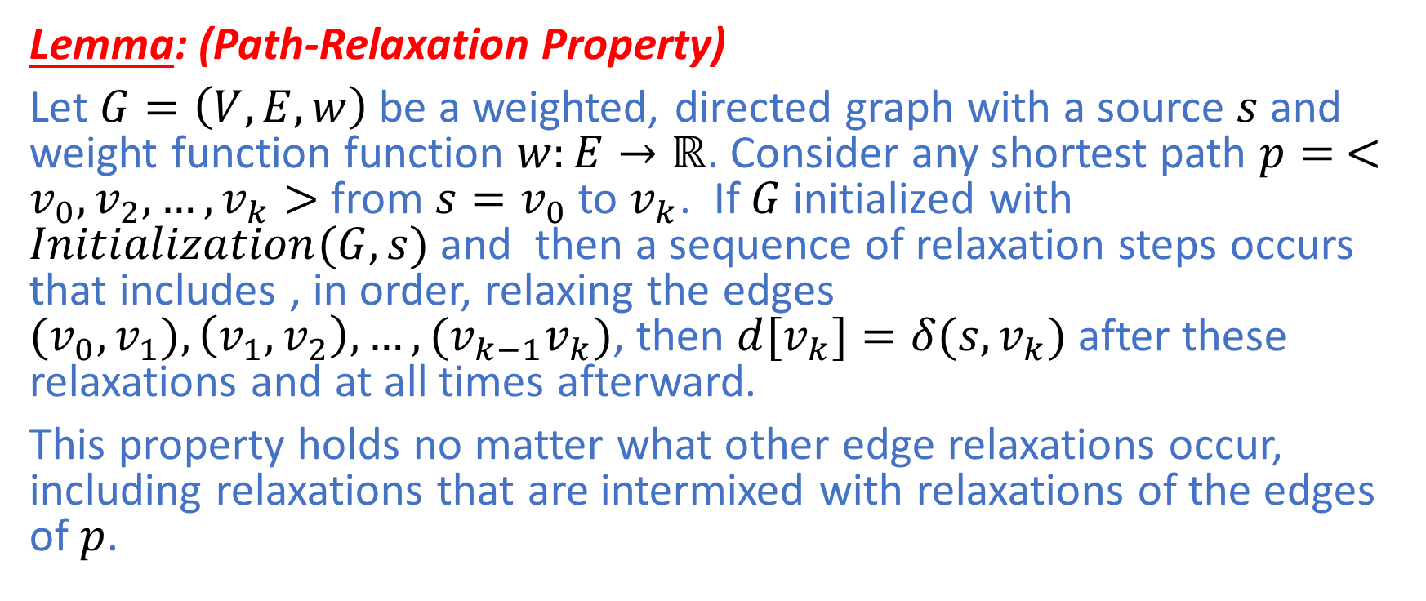
Path-Relaxation Property
Lemma: (Path-Relaxation Property)
Let $G=\left(V,E,w\right)$ be a weighted, directed graph with a source $s$ and weight function function $w:E→ℝ$. Consider any shortest path $p=$ $<v_{0},v_{2},…,v_{k}>$ from $s=v_{0}$ to $v_{k}$. If $G$ initialized with $Initialization(G,s)$ and then a sequence of relaxation steps occurs that includes , in order, relaxing the edges ${(v}_{0},v_{1}),\left(v_{1},v_{2}\right),…,({v_{k−1}v}_{k})$, then ${d[v}_{k}]=δ(s,v_{k})$ after these relaxations and at all times afterward.
This property holds no matter what other edge relaxations occur, including relaxations that are intermixed with relaxations of the edges of $p$.

Slide 42
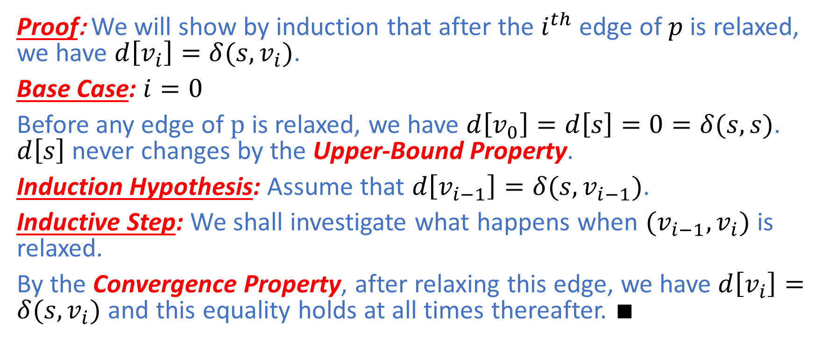
Path-Relaxation Property
Proof: We will show by induction that after the $i^{th}$ edge of $p$ is relaxed, we have $d\left[v_{i}\right]=δ(s,v_{i})$.
Base Case: $i=0$
Before any edge of $p$ is relaxed, we have $d\left[v_{0}\right]=d\left[s\right]=0=δ(s,s)$. $d\left[s\right]$ never changes by the Upper-Bound Property.
Induction Hypothesis: Assume that $d\left[v_{i−1}\right]=δ(s,v_{i−1})$.
Inductive Step: We shall investigate what happens when ${(v}_{i−1},v_{i})$ is relaxed.
By the Convergence Property, after relaxing this edge, we have $d\left[v_{i}\right]=δ(s,v_{i})$ and this equality holds at all times thereafter. $∎$

Slide 43
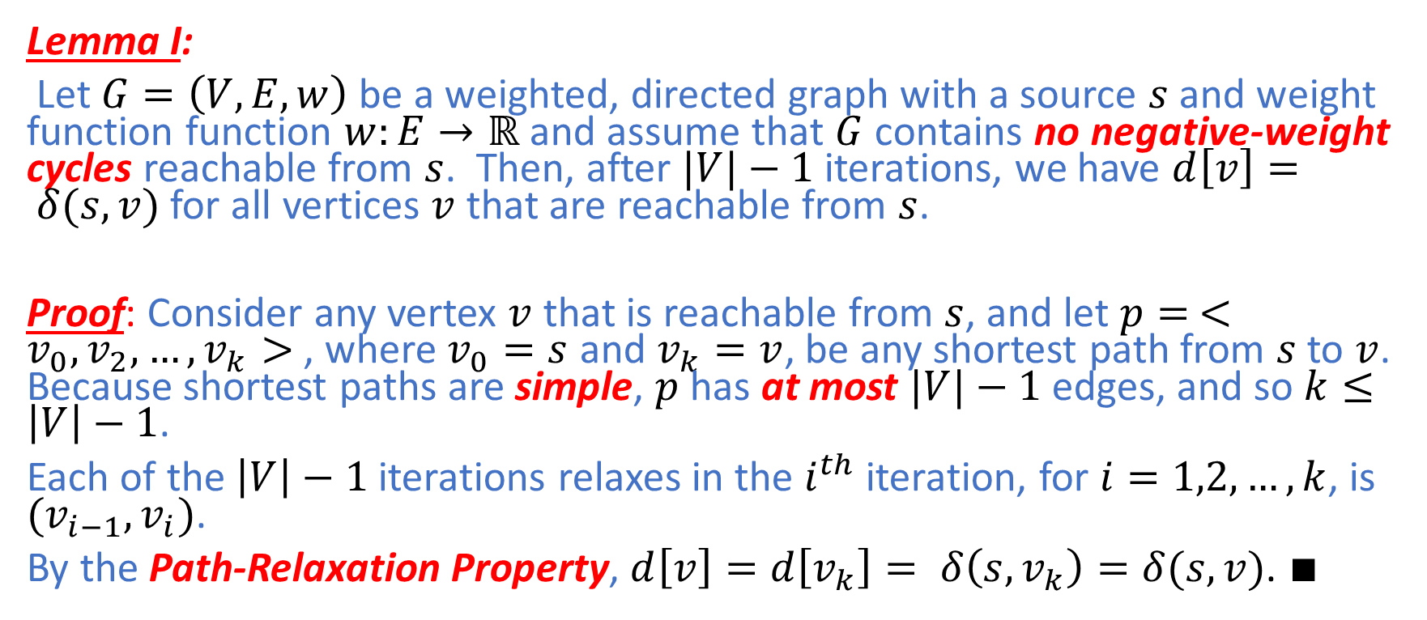
Bellman-Ford: Correctness
Lemma I:
Let $G=\left(V,E,w\right)$ be a weighted, directed graph with a source $s$ and weight function function $w:E→ℝ$ and assume that $G$ contains no negative-weight cycles reachable from $s$. Then, after $|V|−1$ iterations, we have $d\left[v\right]= δ(s,v)$ for all vertices $v$ that are reachable from $s$.
Proof: Consider any vertex $v$ that is reachable from $s$, and let $p=$ $<v_{0},v_{2},…,v_{k}>$ , where $v_{0}=s$ and $v_{k}=v$, be any shortest path from $s$ to $v$. Because shortest paths are simple, $p$ has at most $|V|−1$ edges, and so $k≤\left|V\right|−1$.
Each of the $\left|V\right|−1$ iterations relaxes in the $i^{th}$ iteration, for $i=1,2,…,k$, is ${(v}_{i−1},v_{i})$.
By the Path-Relaxation Property, $d\left[v\right]=d\left[v_{k}\right]= δ\left(s,v_{k}\right)=δ(s,v)$. $∎$

Slide 44
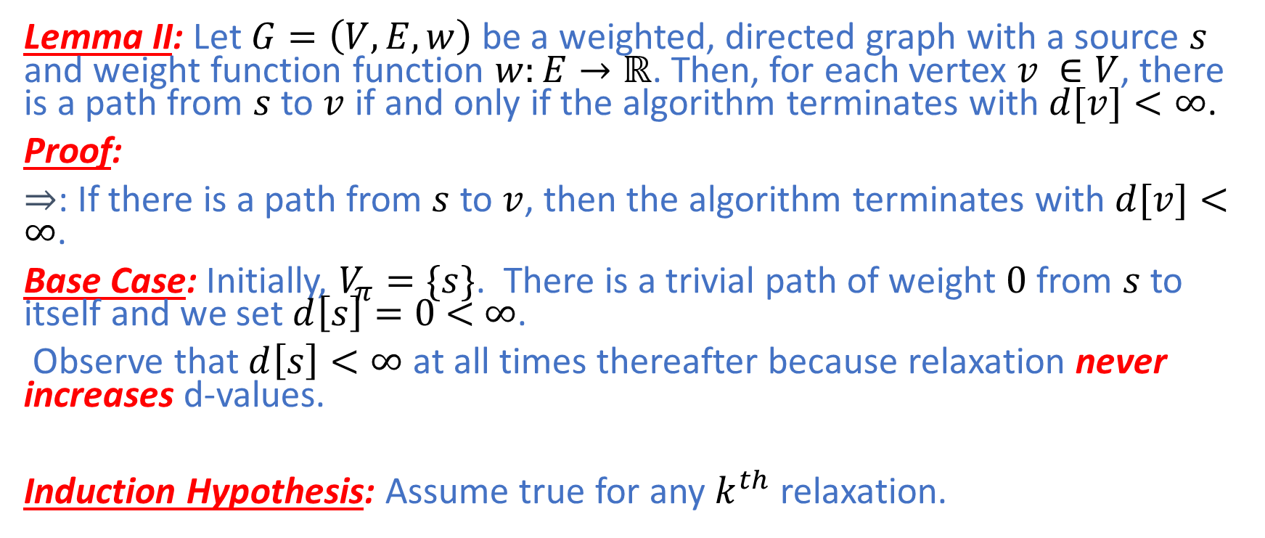
Bellman-Ford: Correctness
Lemma II: Let $G=\left(V,E,w\right)$ be a weighted, directed graph with a source $s$ and weight function function $w:E→ℝ$. Then, for each vertex $v ∈V$, there is a path from $s$ to $v$ if and only if the algorithm terminates with $d[v]<∞$.
Proof:
$⇒$: If there is a path from $s$ to $v$, then the algorithm terminates with $d[v]<$ $∞$.
Base Case: Initially, $V_{π}=\{s\}$. There is a trivial path of weight $0$ from $s$ to itself and we set $d\left[s\right]=0$ $<$ $∞$.
Observe that $d\left[s\right]<∞$ at all times thereafter because relaxation never increases d-values.
Induction Hypothesis: Assume true for any $k^{th}$ relaxation.

Slide 45
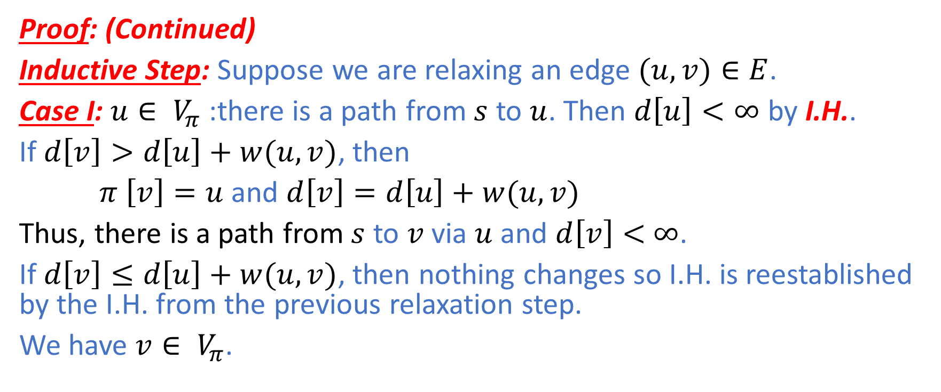
Bellman-Ford: Correctness
Proof: (Continued)
Inductive Step: Suppose we are relaxing an edge $(u,v)∈E$.
Case I: $u∈ V_{π}$:there is a path from $s$ to $u$. Then $d\left[u\right]<∞$ by I.H..
If $d\left[v\right]>d\left[u\right]+w(u,v)$, then
$π \left[v\right]=u$ and $d\left[v\right]=d\left[u\right]+w(u,v)$
Thus, there is a path from $s$ to $v$ via $u$ and $d\left[v\right]<$ $∞$.
If $d\left[v\right]≤d\left[u\right]+w(u,v)$, then nothing changes so I.H. is reestablished by the I.H. from the previous relaxation step.
We have $v∈ V_{π}$.

Slide 46

Bellman-Ford: Correctness
Proof: (Continued)
Inductive Step: Suppose we are relaxing an edge $(u,v)∈E$.
Case II: There is no path from $s$ to $u$.
Thus, $d\left[u\right]=∞=δ(s,u)$ by the No-Path Property.
Since $d\left[v\right]>d\left[u\right]+w(u,v)$ does not hold, nothing changes so I.H. is reestablished by the I.H. from the previous relaxation step.

Slide 47

Bellman-Ford: Correctness
Proof: (Continued)
$⇐$: If the algorithm terminates with $d[v]<$ $∞$, there is a path from $s$ to $v$.
Base Case: Initially, $V_{π}=\{s\}$.
We set $d\left[s\right]=0<∞$.
There is a path of weight $0$ from $s$ to itself.
Observe that $d\left[s\right]<∞$ at all times thereafter because relaxation never increases d-values.
Induction Hypothesis: Assume true for any $k^{th}$ relaxation.

Slide 48

Bellman-Ford: Correctness
Inductive Step: Suppose we are relaxing an edge $(u,v)∈E$.
Case I: $d\left[v\right]>d\left[u\right]+w(u,v)$
Thus, $d\left[u\right]$ must be a finite value so $d[u]<$ $∞$.
Then, there is a path from $s$ to $u$ by I.H..
Therefore, $d\left[v\right]=d\left[u\right]+w(u,v)$ and $π\left[v\right]=u$.
This establishes a path from $s$ to $v$ via $u$ and $d\left[v\right]$ is now a finite value so $d[v]<$ $∞$.

Slide 49

Bellman-Ford: Correctness
Inductive Step: Suppose we are relaxing an edge $(u,v)∈E$.
Case II: $d\left[v\right]≤d\left[u\right]+w(u,v)$
Thus, nothing changes so I.H. is reestablished by the I.H. from the previous relaxation step.
Therefore, we have proved the invariant:
there is a path from $s$ to $v$ if and only if $d\left[v\right]<∞$.
Termination: If $d\left[v\right]<∞$ just after $\left|V\right|−1$ iterations, then , $d\left[v\right]<$ $∞$ remains true thereafter because relaxation never increases d-values. $∎$

Slide 50

Bellman-Ford: Correctness
Theorem: Let Bellman-Ford be run on a weighted, directed graph $G=\left(V,E,w\right)$ with source $s$ and weight function $w:E→ℝ$.
(Claim I) If $G$ contains no negative-weight cycles that are reachable from $s$, the algorithm returns TRUE, we have $d\left[v\right]= δ(s,v)$ for all vertices $v∈V$.
(Claim II)If $G$ does contain a negative-weight cycle reachable from $s$ then the algorithm returns FALSE.

Slide 51

Bellman-Ford: Correctness
Proof: (Claim I)
Suppose $G$ contains no negative-weight cycles that are reachable from $s$.
(Claim III) We first prove the claim that $d\left[v\right]= δ(s,v)$ for all vertices $v∈V$.
By Lemma I, we prove Claim III for those vertices$v$ reachable from $s$.
By the No-Path Property, we prove Claim III for those vertices $v$ not reachable from $s$.

Slide 52

Bellman-Ford: Correctness
Proof: (Claim I)
At termination, for all edges $(u,v)∈E$, we have
$d\left[v\right]= δ\left(s,v\right)$ [Claim III: $d\left[v\right]=δ\left(s,v\right)$]
$≤ δ\left(s,u\right)+w(u,v)$ [Triangle Inequality]
$=d\left[u\right]+w(u,v)$ [$\text{Claim} \text{III}:d\left[u\right]=δ\left(s,u\right)$]
Therefore, we have $d\left[v\right]≤d\left[u\right]+w(u,v)$ so it does not pass the if condition in the extra pass. Therefore, the algorithm returns TRUE. $∎$

Slide 53

Bellman-Ford: Correctness
Proof: (Claim II)
Suppose that $G$ contains a negative-weight cycle reachable from $s$ and let this cycle be $c=<v_{0}, v_{1},…,v_{k}>$, where $v_{0}=v_{k}$.
Then, we have the sum of all the edge weights in this cycle $\sum_{i=1}^{k}{w\left(v_{i−1},v_{i}\right)<0}$. ---(1)
Assume for the purpose of contradiction that the algorithm return TRUE.
Thus, we must have
$d\left[v_{i}\right]≤d\left[v_{i−1}\right]+w(v_{i−1},v_{i})$ for $i=1,2,…,k$. ---(2)

Slide 54

Bellman-Ford: Correctness
Proof: (Claim II)
$d\left[v_{i}\right]≤d\left[v_{i−1}\right]+w(v_{i−1},v_{i})$ for $i=1,2,…,k$. ---(2)
Summing Eq.(2) around the cycle $c$, we have
$\sum_{i=1}^{k}{d\left[v_{i}\right]}≤\sum_{i=1}^{k}{d\left[v_{i−1}\right]}+\sum_{i=1}^{k}{w(v_{i−1},v_{i})}$ ---(3)
Observe since $v_{0}=v_{k}$, each vertex appear in $c$exactly once in each of the summations $\sum_{i=1}^{k}{d\left[v_{i}\right]}$ and $\sum_{i=1}^{k}{d\left[v_{i−1}\right]}$.
Thus, $\sum_{i=1}^{k}{d\left[v_{i}\right]}=\sum_{i=1}^{k}{d\left[v_{i−1}\right]}$.
We can rewrite Eq.(3) as
$\sum_{i=1}^{k}{d\left[v_{i}\right]}≤\sum_{i=1}^{k}{d\left[v_{i}\right]}+\sum_{i=1}^{k}{w(v_{i−1},v_{i})}$ ---(4)

Slide 55

Bellman-Ford: Correctness
Proof: (Claim II)
By Lemma II, $d\left[v_{i}\right]<∞$, i.e., d-value is finite,
The terms $\sum_{i=1}^{k}{d\left[v_{i}\right]}$ on both sides legitimately cancel out and we have
$0≤\sum_{i=1}^{k}{w(v_{i−1},v_{i})}$
,which contradicts our assumption in Eq.(1).
Hence, the algorithm must return FALSE in the presence of a negative-weight cycle that is reachable from $s$. $∎$
Thus, we can conclude that Bellman-Ford returns TRUE if $G$ contains no negative-weight cycles reachable from $s$.
Otherwise, it returns FALSE. $∎$

Slide 56
Summary
In this lecture, we have covered the topic of single-source shortest path problems:
Dijkstra’s Single-Source Shortest Path
Bellman-Ford
In the next lecture, we will cover more on shortest path problems.

